Slide 1
Development of a Web-based Traffic Accident Management Information System
Khu, Windyl Joseph A.
Estanilla, Danneille Clifford G.
Vallejos, Kenneth P.
Libago Jr, Norberto Q.
Adviser: Elvira B. Yaneza
BS Computer Science, Xavier University

Slide 2
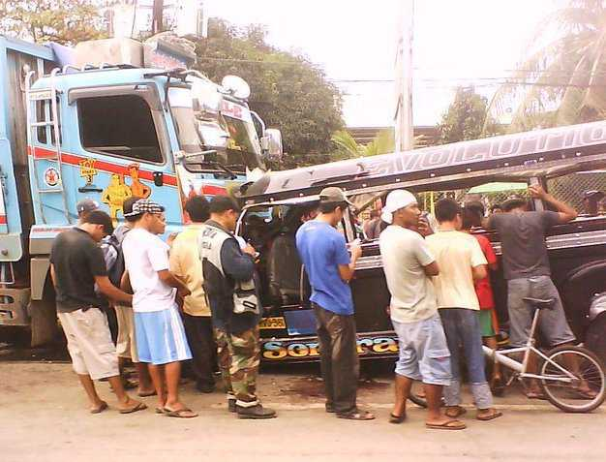

Introduction
Rapid growth of traffic accident rate has been recorded in the statistical record by Land Transportation Office (LTO). In Fact Region X has the highest frequency rate dated on May 2011 released by LTO.
The local government and community in Region X desperately needs a traffic accident management information system which will reduce the traffic accident rate, save more lives, prevent traffic congestion, and promote Cagayan de Oro (CDO) City as a technologically competitive province.

Slide 3
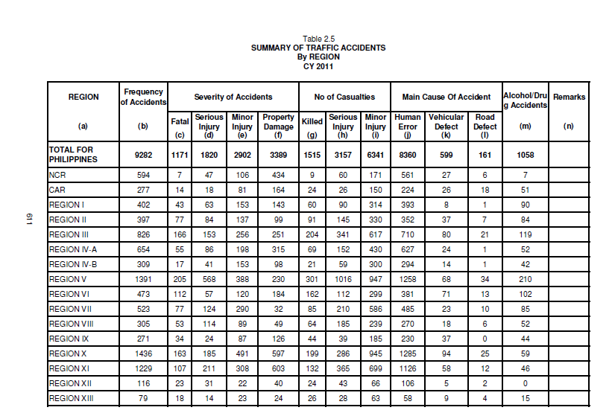

Slide 4
Statement of the Problem
When a traffic accident occurs…
there is no direct in-charge entity to call to,
lack of information of CDO community on what to do or who to call,
cause traffic congestion which is a problem for commuters and can affect the economy, and
there is a possibility of lack of identification of the injured person involved in the traffic accident.

Slide 5
General Objective
To develop a traffic accident management information system.

Slide 6
Specific Objectives
This project specifically aims to accomplish the following:
To gather data like confidentiality policies, traffic accidents standard operating procedures and contact details from the following local entities: Traffic Administration Offices, Police Departments, and Hospitals.
To gather information on how the following entities respond to traffic accidents,
To identify procedures on how these three entities communicate with the immediate relation or next of kin of the injured person involved in the accident,
To develop Traffic Accident Management Information System.
To pilot test and evaluate the effectiveness of the system.

Slide 7
Significance of The Study
The resulting system will significantly improve coordination between the police authorities, traffic administrators, and hospitals. This means that there will be a faster response speed of these entities increasing the probability of saving lives and preventing traffic congestion. The system will also be a means to automate the recording of traffic accident reports and store it in a database.

Slide 8
Scope and Limitations
The study will be limited to traffic accident data and standard operating procedures gathered from the three entities within Cagayan de Oro City.
The TAMIS will only cater to traffic accidents categorized as vehicles colliding with another vehicle, pedestrian, or other stationary obstruction and that it results in injury, death, vehicle damage and property damage.

Slide 9
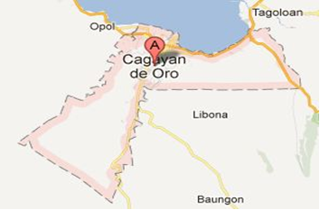
Location Map Of CDOC

Slide 10
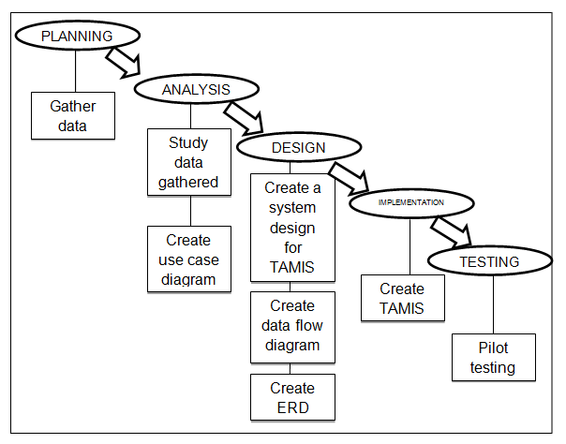
Research Methodology

Slide 11
System Design
In this system, the three major modules are
the Short Message Service (SMS) alert function,
data representation,
and functions modules.
The TAMIS for Cagayan de Oro City will be implemented as a web application. Since the system incorporated the Code Igniter framework.

Slide 12
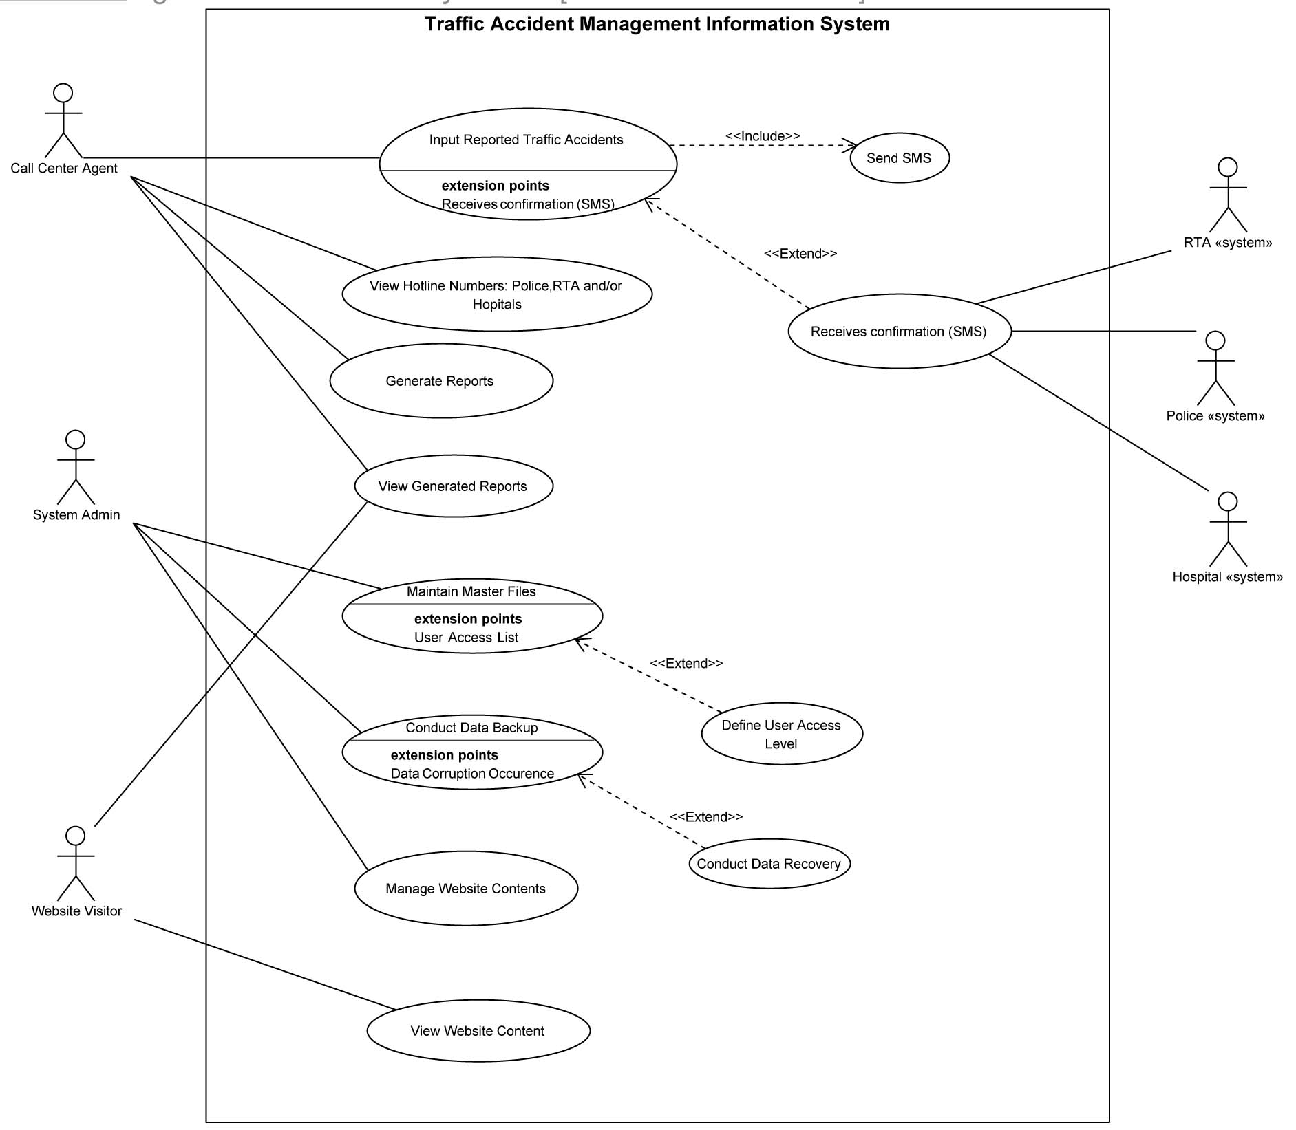

Slide 13
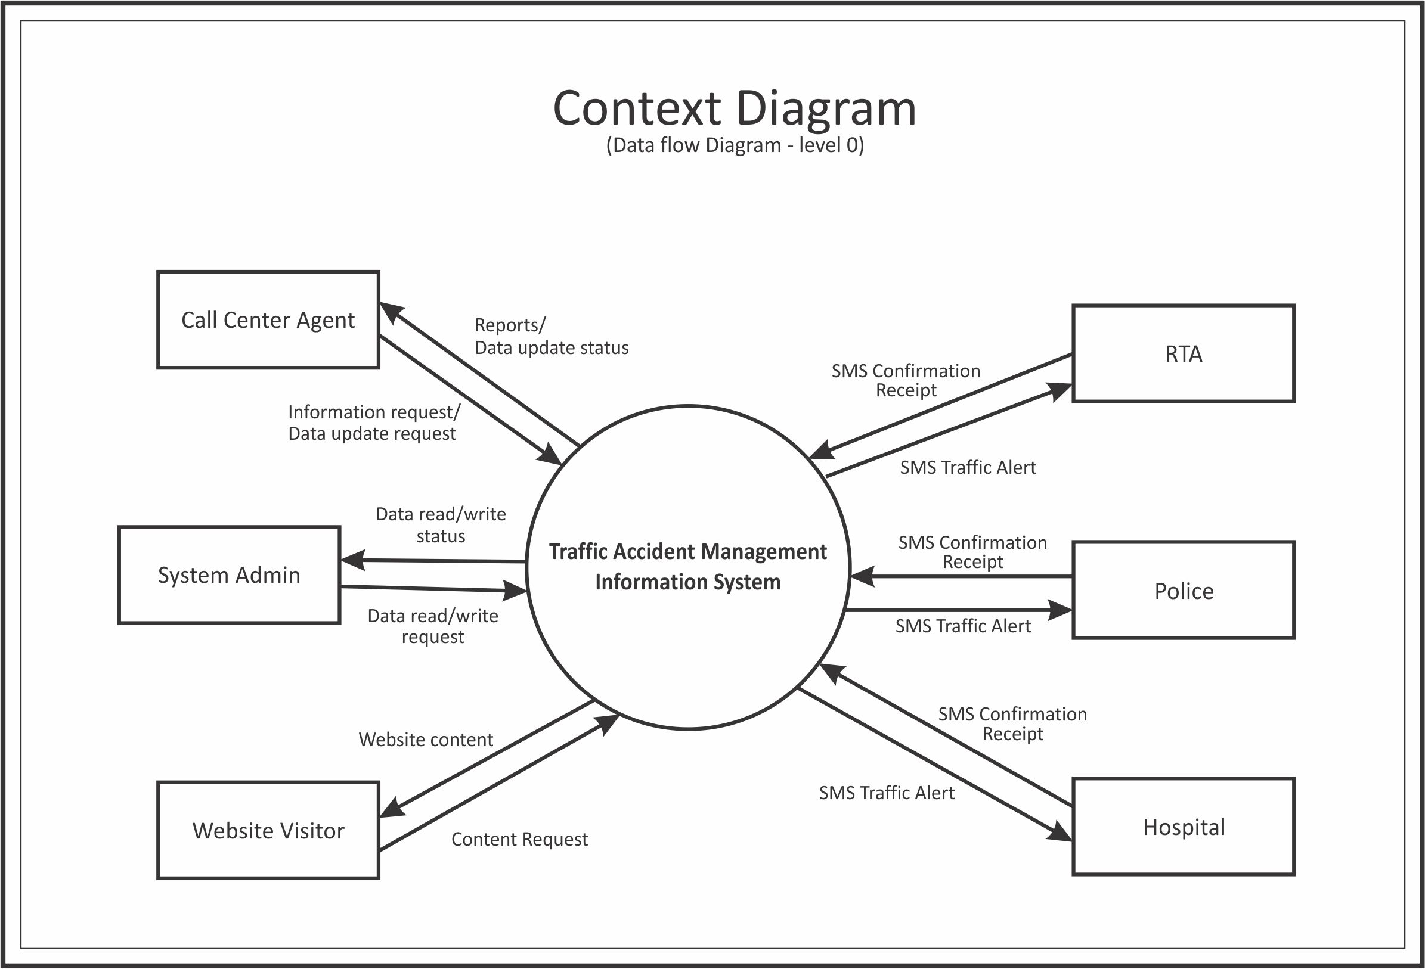

Slide 14
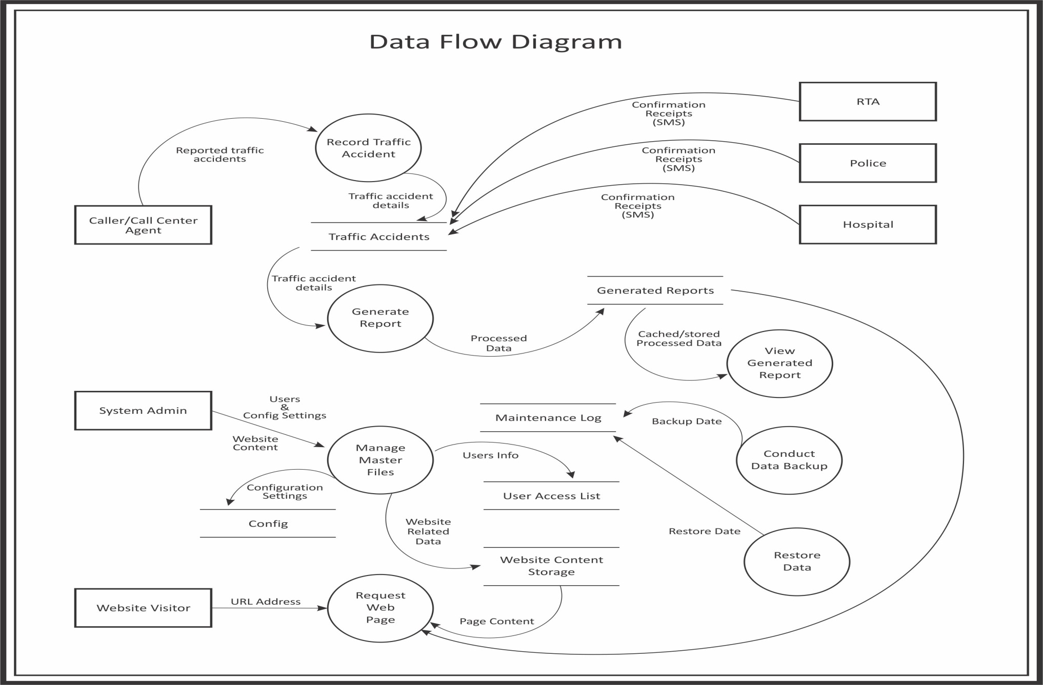

Slide 15
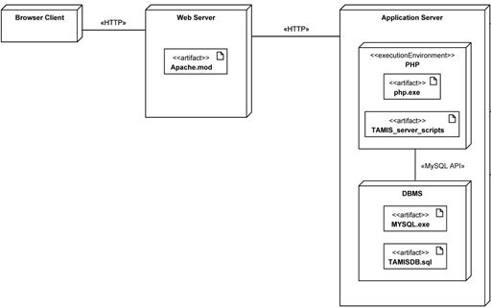
Deployment Diagram for TAMIS

Slide 16
Testing
Pilot Tests will be conducted to assess whether or not the objectives were properly met and satisfied upon the implementation of the system and that it is fully functional or bug-free.
Pilot testing will involve at most ten people chosen by the proponents to act as callers and supply sample records or inputs. Contact numbers of another set of chosen people will be substituted for those from police authorities, traffic administrators, and hospitals who would be contact persons of the system. These contacts will be the ones receiving the automated SMS messages from TAMIS when traffic accident data is acquired. Through this testing, functionality and ease of use can be evaluated and bugs can be found and corrected. Furthermore, the pilot testers can give feedback on the features and functions of TAMIS.

Slide 17
Evaluation
After testing, the evaluation on the effectiveness of TAMIS will be conducted. A rubric will be used to rate the effectiveness of the system. The criteria will include the effectiveness the SMS functionality, the improvement of the response of time of the entities and the overall effectiveness of the system in saving lives.

